Slide 1
PYTHON CORE INTRODUCTION

Slide 2
AGENDA
More information about Python
Python features
Python history
Introduction to Python Platform.
Environment and Development Tools for Java applications
Eclipse IDE Tips & Tricks
The Entry Point into the Program
Java Packages. Introduction
My first program

Slide 3
More information about Python
http://python.org/
- documentation, tutorials, beginners guide, core distribution, ...
Books include:
Learning Python by Mark Lutz
Python Essential Reference by David Beazley
Python Cookbook, ed. by Martelli, Ravenscroft and Ascher
online at
https://www.w3schools.com/python/
https://www.udemy.com/python-101-beginners-coding-bootcamp-free-course/

Slide 4
Python features
Python is an interpreted, interactive, object-oriented programming language.
Python is a general-purpose, high-level programming language whose design philosophy emphasizes code readability.
Python aims to combine "remarkable power with very clear syntax",
and its standard library is large and comprehensive.
Its use of indentation for block delimiters is unusual among popular programming languages.
Python features a dynamic type system and automatic memory management. It supports multiple programming paradigms, including object-oriented, imperative, functional and procedural, and has a large and comprehensive standard library.

Slide 5

Python history
Python created
by Guido van Rossum
and first released
in 1991.
Python 1.0 - January 1994
Python 1.5 - December 31, 1997
Python 1.6 - September 5, 2000
Python 2.0 - October 16, 2000
Python 2.1 - April 17, 2001
Python 2.2 - December 21, 2001
Python 2.3 - July 29, 2003
Python 2.4 - November 30, 2004
Python 2.5 - September 19, 2006
Python 2.6 - October 1, 2008
Python 2.7 - July 3, 2010
Python 3.0 - December 3, 2008
Python 3.1 - June 27, 2009
Python 3.2 - February 20, 2011
Python 3.3 - September 29, 2012
Python 3.4 - March 16, 2014
Python 3.5 - September 13, 2015

Slide 6










Python Overview
Cisco, Inc – Web security (e-mail, www)
Yahoo (Maps, Groups)
Google – many components of the Google spider and search engine are written in Python
YouTube – entirely written in Python
Zope Corporation – has developed a powerful Web application framework server using Python
Linux Weekly News
George Lucas’ Film Company - Industry Light and Magic – uses Python in the production of their FX
Walt Disney Feature Animation
NASA – uses Python in its integrated Planning System and Mission Control Center. Python is going to replace other tools written in Perl and shell dialects

Slide 7
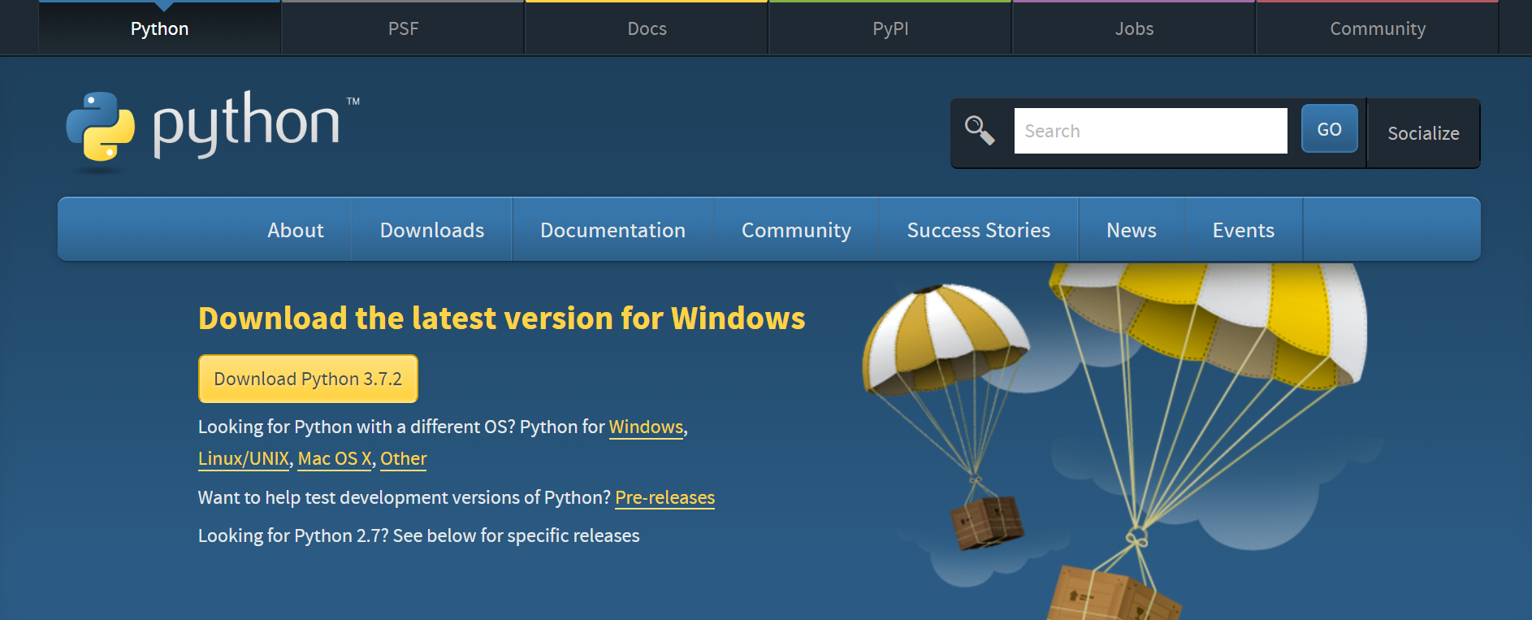
Python download
https://www.python.org/downloads/

Slide 8
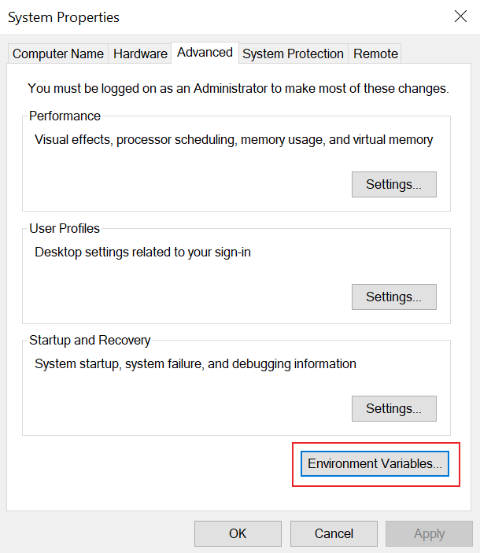
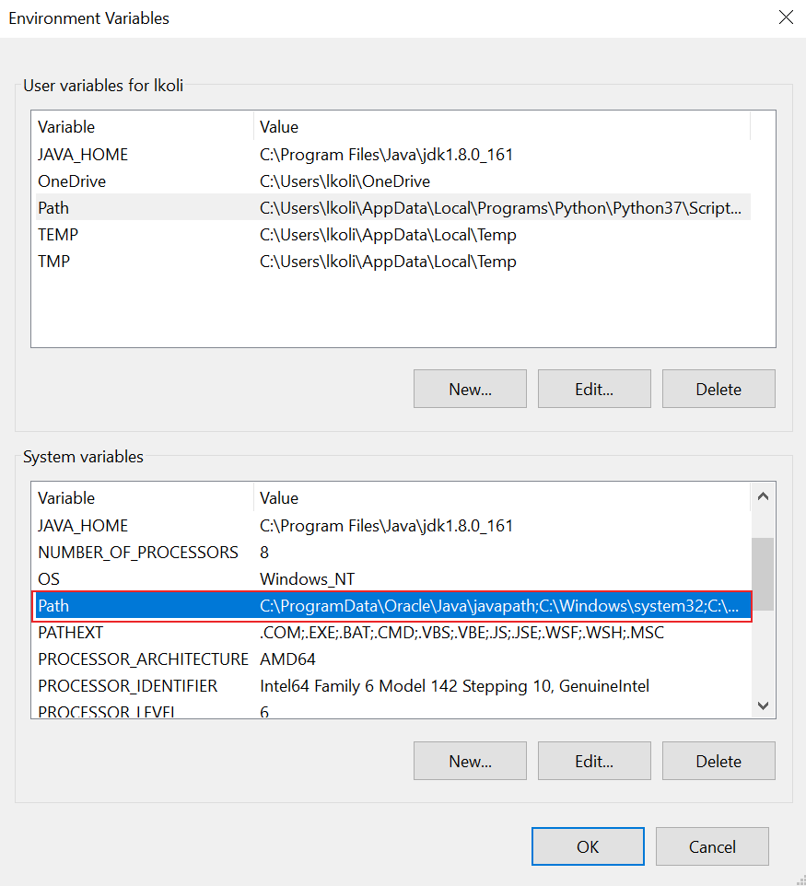
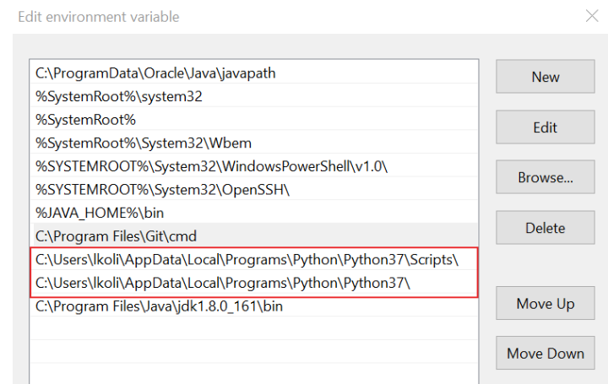
Install Python
Add Python to the PATH Environmental Variable
You must append your installation path
(example: C:\Users\lkoli\AppData\Local\Programs\Python\Python37\)
to the PATH variable in System variables.

Slide 9
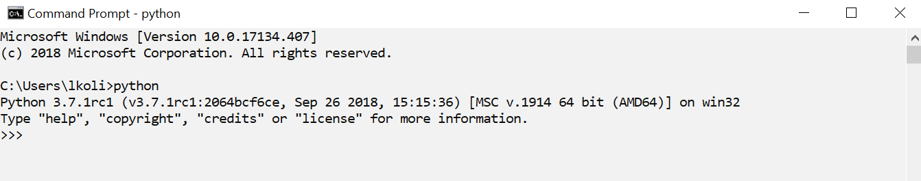
Install Python
Next step:
open your command line and type python

Slide 10
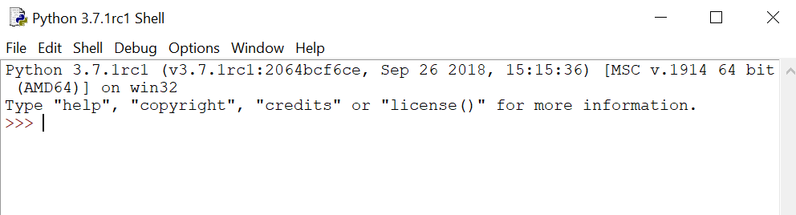
Python Interactive Shell
Python 3.7.1rc1 (v3.7.1rc1:2064bcf6ce, Sep 26 2018, 15:15:36) [MSC v.1914 64 bit (AMD64)] on win32
Type "help", "copyright", "credits" or "license()" for more information.
>>>

Slide 11
Online Python compiler
https://www.tutorialspoint.com/execute_python_online.php
https://www.jdoodle.com/python3-programming-online
https://www.onlinegdb.com/online_python_compiler
https://repl.it/repls/DimpledRottenOperation
https://ideone.com/
https://www.beta.browxy.com/
https://paiza.io/projects/sepDWD3s9TLX_8GKIvvbXA?language=python3

Slide 12
Environment, Development Tools
IDLE multi-window colorized source browser, autoindent, autocompletion, tool tips, code context panel, search in files, class and path browsers, debugger, executes code in clean separate subprocess with one keystroke. 100% pure Python, part of Python 2.x and 3.x distributions (may be packaged separately in some situations).
NetBeans is open source, allows Python and Jython Editing, code-completion, debugger, refactoring, templates, syntax analysis, etc.
Komodo is a multi-language IDE with support for Python 2.x and Python 3. Available as Komodo IDE (commercial).

Slide 13
Environment, Development Tools
PyCharm Community is a free open-source IDE with a smart Python editor providing quick code navigation, code completion, refactoring, unit testing and debugger. Commercial Professional edition fully supports Web development with Django, Flask, Mako
IntelliJ IDEA is a commercial Java IDE by JetBrains. It is often simply referred to as 'IDEA' or 'IntelliJ'. A 30-day fully functional trial of the IntelliJ IDEA commercial edition for various platforms can be freely downloaded. Community Edition is open-source

Slide 14
Environment, Development Tools
Microsoft Visual Studio is an integrated development environment (IDE) from Microsoft.
Cloud9 IDE is an online integrated development environment, published as open sourse from version 2.0, until version 3.0. It supports multiple programming languages, including C, C++, Ruby, Python, JavaScript with Node.js, and Go.
LiClipse is commercial Eclipse-based IDE which provides a standalone bundling PyDev, Workspace Mechanic, Eclipse Color Theme, StartExplorer and AnyEdit, along with lightweigth support for other languages, and other usability enhancements (such as multi-caret-edition).

Slide 15
Python philosophy: The Zen of Python, by Tim Peters
import this
Beautiful is better than ugly.
Explicit is better than implicit.
Simple is better than complex.
Complex is better than complicated.
Flat is better than nested.
Sparse is better than dense.
Readability counts.
Special cases aren't special enough to break the rules.
Although practicality beats purity.
Errors should never pass silently.
Unless explicitly silenced.
In the face of ambiguity, refuse the temptation to guess.
There should be one-- and preferably only one --obvious way to do it.
Although that way may not be obvious at first unless you're Dutch.
Now is better than never.
Although never is often better than *right* now.
If the implementation is hard to explain, it's a bad idea.
If the implementation is easy to explain, it may be a good idea.
Namespaces are one honking great idea -- let's do more of those!

Slide 16
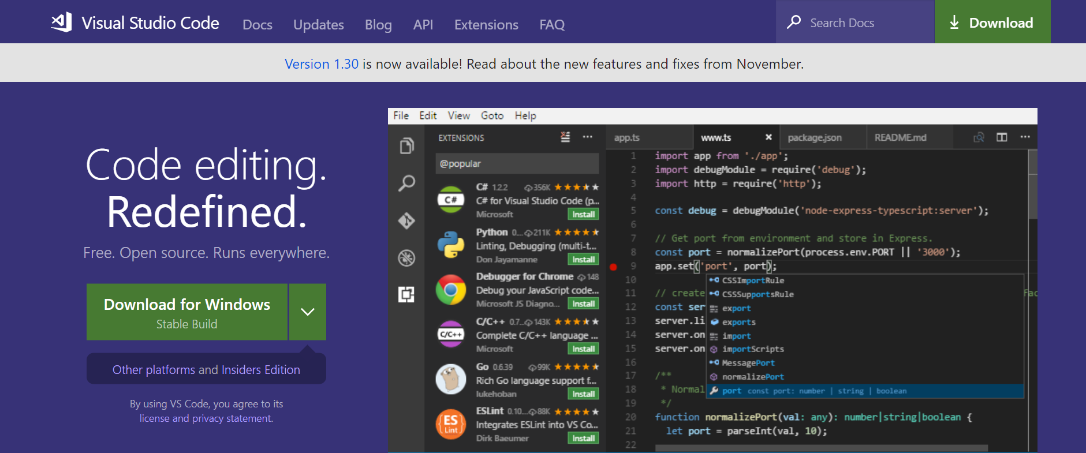
Visual Studio Code

Slide 17
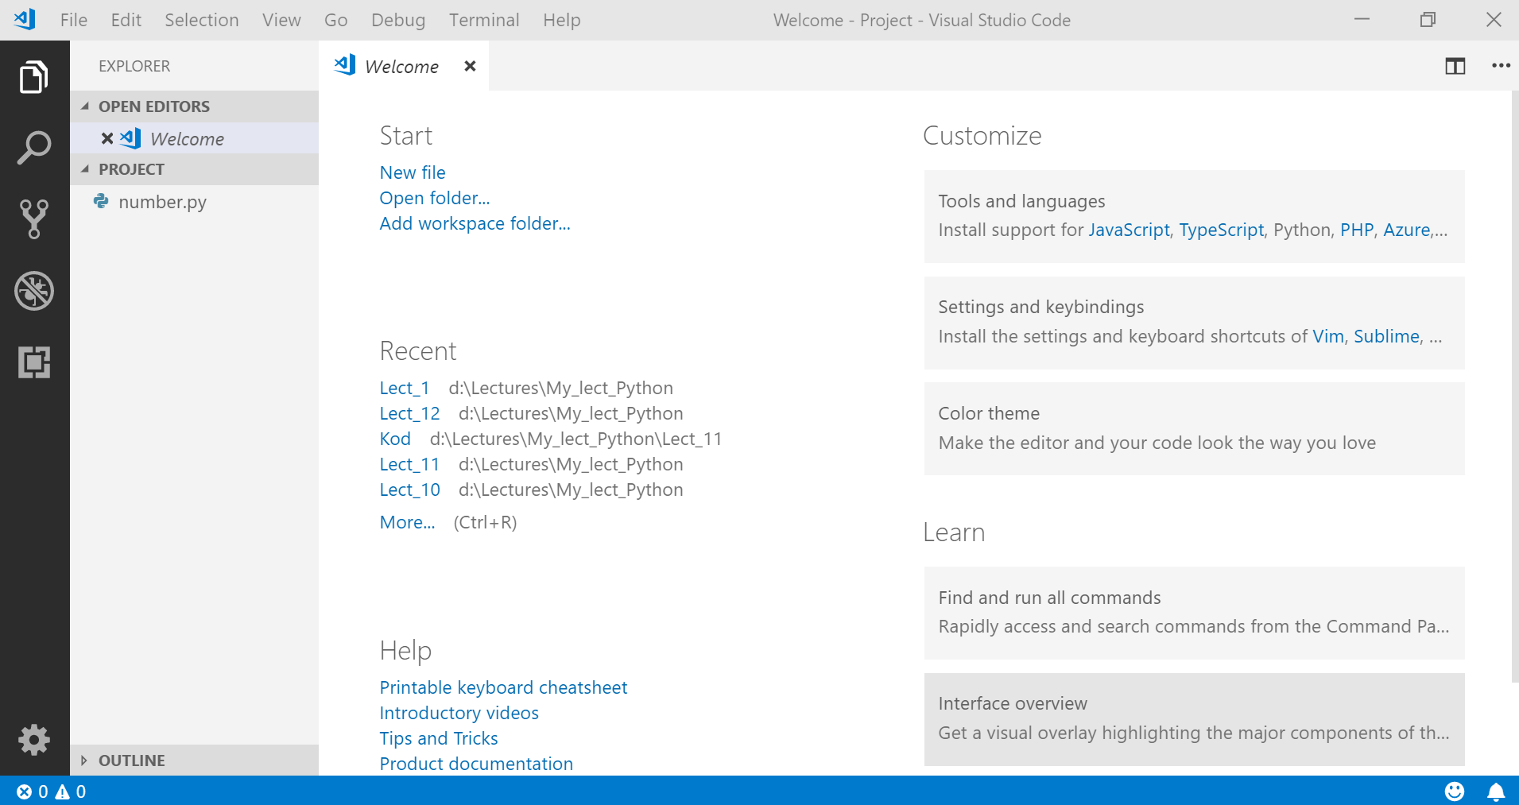
Visual Studio Code

Slide 18
Python Variables
In most of the programming languages a variable is a named location used to store data in the memory. Each variable must have a unique name called identifier. It is helpful to think of variables as container that hold data which can be changed later throughout programming.
In Python we don't assign values to the variables, where as Python gives the reference of the object (value) to the variable.
In Python, variables do not need declaration to reserve memory space. The "variable declaration" or "variable initialization" happens automatically when we assign a value to a variable.
A process in which a variable is set to its first value is called initialization.

Slide 19
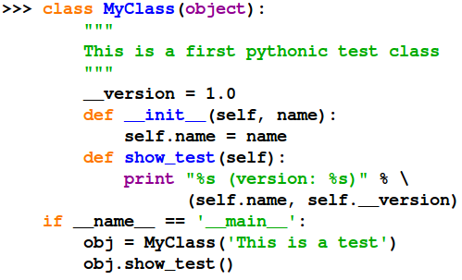
Python Syntax
Python is intended to be a highly readable language. It is designed to have an uncluttered visual layout, frequently using English keywords where other languages use punctuation. Python requires less boilerplate than traditional manifestly typed structured languages such as C or Pascal, and has a smaller number of syntactic exceptions and special cases than either of these
Indentation - Python uses whitespace indentation, rather than curly braces or keywords, to delimit blocks (a feature also known as the off-side rule):
increase in indentation comes after certain statements;
decrease in indentation signifies the end of the current block
Use '\' when must go to next line prematurely
Notes:
Indentation
Use 4 spaces per indentation level. Tabs or Spaces?
Spaces are the preferred indentation method.
Python 3 disallows mixing the use of tabs and spaces for indentation.
When invoking the Python 2 command line interpreter with the -t option, it issues warnings about code that illegally mixes tabs and spaces. When using -tt these warnings become errors. These options are highly recommended!
Maximum Line Length
Limit all lines to a maximum of 79 characters.
Blank Lines
Surround top-level function and class definitions with two blank lines.
Method definitions inside a class are surrounded by a single blank line. Underscore 213down vote
__foo__: this is just a convention, a way for the Python system to use names that won't conflict with user names.
_foo: this is just a convention, a way for the programmer to indicate that the variable is private (whatever that means in Python).
__foo: this has real meaning: the interpreter replaces this name with _classname__foo as a way to ensure that the name will not overlap with a similar name in another class.
No other form of underscores have meaning in the Python world.
https://www.python.org/dev/peps/pep-0008/

Slide 20
Python Identifiers
Identifier is the name given to entities like class, functions, variables etc. in Python. It helps differentiating one entity from another.
Rules for writing identifiers
Identifiers can be a combination of letters in lowercase (a to z) or uppercase (A to Z) or digits (0 to 9) or an underscore (_). Names like myClass, var_1 and print_this_to_screen, all are valid example.
An identifier cannot start with a digit. 1variable is invalid, but variable1 is perfectly fine.
Keywords cannot be used as identifiers.
We cannot use special symbols like !, @, #, $, % etc. in our identifier.
Things to care about
Python is a case-sensitive language. This means, Variable and variable are not the same. Always name identifiers that make sense.
While, c = 10 is valid. Writing count = 10 would make more sense and it would be easier to figure out what it does even when you look at your code after a long gap.
Multiple words can be separated using an underscore, this_is_a_long_variable.
We can also use camel-case style of writing, i.e., capitalize every first letter of the word except the initial word without any spaces. For example: camelCaseExample

Slide 21
Python Syntax - Enough to Understand the Code
Assignment uses = and comparison uses ==.
For numbers +-*/% are as expected.
Special use of + for string concatenation.
Special use of % for string formatting.
Logical operators are words (and, or, not) not symbols (&&, ||, !).
First assignment to a variable will create it.
Variable types don’t need to be declared.
Python figures out the variable types on its own.
Variables
No need to declare
The variable name is case sensitive: ‘val’ is not the same as ‘Val’
Variables are created when they are assigned
A variable can be reassigned to whatever, whenever (functions, modules, classes)
The type of the variable is determined by Python

Slide 22
What modules and packages

Slide 23
Modules
A module is a file containing Python definitions and statements
File should have suffix.py
Within a module, the module’s name is available as through global variable _name_.
Use “import module-name” to import the functions in this module
It is not required to place all import statements at the beginning of a module
Some modules are built-in e.g. sys
Notes:
http://www.vitaliypodoba.com/tutorials/python2-beginners-course/lesson9-python-modules/ https://uk.wikibooks.org/wiki/%D0%9F%D1%96%D0%B4%D1%80%D1%83%D1%87%D0%BD%D0%B8%D0%BA_%D0%BC%D0%BE%D0%B2%D0%B8_Python/%D0%9C%D0%BE%D0%B4%D1%83%D0%BB%D1%96
# це головна програма наша - mainprogam.py
# імпортуємо інший модуль, під назвою moduletest
import moduletest
_______
# використання імпортованих змінних, функцій та класів;
# для цього використовуємо форму <назва імпортованого модуля>.<назва змінної>
print moduletest.years
stil = moduletest.Table()
stil.details() ____ from moduletest import hello_world
from moduletest import years
# або також ми можемо імпортнути кілька імен одним рядочком, через кому
from moduletest import hello_world, years _______________
# імпортуємо усе з модуля moduletest
from moduletest import *
# після цього маємо в полі імен нашого поточного файлика усі
# змінні, функції та класи з вище імпортованого модуля
print hello_world() ___________________________
# імпортуємо функцію hello_world з модуля module1
# і присвоюємо їй локальну назву hello_world_1
from module1 import hello_world as hello_world_1
# а тепер функцію hello_world з модуля module2
from mobule2 import hello_world as hello_world_2
# таким чином в просторі локальних імен маємо два нових імені
# hello_world_1 та hello_world_2, але не hello_world
print hello_world_1() print hello_world_2()

Slide 24
Modules
Import module fibo
# Fibonacci numbers module fibo.py
def fib(n): # write Fibonacci series up to n
a, b = 0, 1
while b < n:
print(b, end=' ')
a, b = b, a+b
print()
def fib2(n): # return Fibonacci series up to n
result = []
a, b = 0, 1
while b < n:
result.append(b)
a, b = b, a+b
return result
>>> import fibo
Using the module name you can access the functions
>>> fibo.fib(1000)
1 1 2 3 5 8 13 21 34 55 89 144 233 377 610 987
>>> fibo.fib2(100)
[1, 1, 2, 3, 5, 8, 13, 21, 34, 55, 89]
>>> fibo.__name__ 'fibo'
If you intend to use a function often:
>>> fib = fibo.fib
>>> fib(500) 1 1 2 3 5 8 13 21 34 55 89 144 233 377
>>> from fibo import fib, fib2
>>> fib(500) 1 1 2 3 5 8 13 21 34 55 89 144 233 377
>>> from fibo import *
>>> fib(500)

Slide 25
Python Package
Packages are a way of structuring Python’s module namespace by using “dotted module names”
When importing the package, Python searches through the directories on sys.path looking for the package subdirectory.
To import module C you can use:
import A.B.C and use the fully qualified name print A.B.C.my_func()
To import module or function from the package use following:
from A.B import C and use C only by its name (without package prefix) print C.my_func()
The __init__.py files are required for Python package( can be empty but must be present in package dir)
Location of Python package can be localpath or must be defined in “sys.path” (PATH):
import sys
sys.path
sys.path.append(<location>)
Notes:
https://uk.wikibooks.org/wiki/%D0%9F%D1%96%D0%B4%D1%80%D1%83%D1%87%D0%BD%D0%B8%D0%BA_%D0%BC%D0%BE%D0%B2%D0%B8_Python/%D0%9C%D0%BE%D0%B4%D1%83%D0%BB%D1%96 Пакети — це засіб організації іменного простору модулів Пайтона шляхом використання "нотації крапками" ("dotted module names). Наприклад, назва модуля A.B вказує на підмодуль "B" у пакеті "A". Подібно до того як використання модулів позбавляє авторів зайвих тривог щодо назв глобальних змінних, визначених кимось іншим, використання назв модулів, з'єднаних крапками, допомагає авторам багатомодульних пакетів (як, скажімо, NumPy чи графічної бібліотеки Python Imaging Library) уникати проблем, пов'язаних з використанням однакових назв модулів. ____можлива структура вашого пакета (виражену у термінах ієрархічної файлової системи)___ Sound/ Пакет найвищого рівня
__init__.py Ініціалізація звукового пакета
Formats/ Підпакет конвертування форматів файлів
__init__.py
wavread.py
wavwrite.py
aiffread.py
aiffwrite.py
...
Effects/ Підпакет звукових ефектів
__init__.py
echo.py
surround.py
reverse.py
Filters/ Підпакет фільтрів
__init__.py
equalizer.py
vocoder.py __________________________________________________________________ import Sound.Effects.echo __________________________________________________________________

Slide 26
Python Package
Packages are a way of structuring Python’s module namespace by using “dotted module names”
When importing the package, Python searches through the directories on sys.path looking for the package subdirectory.
To import module C you can use:
import A.B.C and use the fully qualified name print A.B.C.my_func()
To import module or function from the package use following:
from A.B import C and use C only by its name (without package prefix) print C.my_func()
The __init__.py files are required for Python package( can be empty but must be present in package dir)
Location of Python package can be localpath or must be defined in “sys.path” (PATH):
import sys
sys.path
sys.path.append(<location>)
Notes:
https://uk.wikibooks.org/wiki/%D0%9F%D1%96%D0%B4%D1%80%D1%83%D1%87%D0%BD%D0%B8%D0%BA_%D0%BC%D0%BE%D0%B2%D0%B8_Python/%D0%9C%D0%BE%D0%B4%D1%83%D0%BB%D1%96 Пакети — це засіб організації іменного простору модулів Пайтона шляхом використання "нотації крапками" ("dotted module names). Наприклад, назва модуля A.B вказує на підмодуль "B" у пакеті "A". Подібно до того як використання модулів позбавляє авторів зайвих тривог щодо назв глобальних змінних, визначених кимось іншим, використання назв модулів, з'єднаних крапками, допомагає авторам багатомодульних пакетів (як, скажімо, NumPy чи графічної бібліотеки Python Imaging Library) уникати проблем, пов'язаних з використанням однакових назв модулів. ____можлива структура вашого пакета (виражену у термінах ієрархічної файлової системи)___ Sound/ Пакет найвищого рівня
__init__.py Ініціалізація звукового пакета
Formats/ Підпакет конвертування форматів файлів
__init__.py
wavread.py
wavwrite.py
aiffread.py
aiffwrite.py
...
Effects/ Підпакет звукових ефектів
__init__.py
echo.py
surround.py
reverse.py
Filters/ Підпакет фільтрів
__init__.py
equalizer.py
vocoder.py __________________________________________________________________ import Sound.Effects.echo __________________________________________________________________

Slide 27
Using packages in Python
fincalc
|-- __init__.py
|-- simper.py
|-- compper.py
|-- annuity.py
Module __init.py__ may be empty, or may contain a variable __all__
__all__ = ["simper", "compper", "annuity"]

Slide 28
Structure of packages
Sound # main packege
__init__.py #nitialization of package
Formats # sub packege
__init__.py
wavread.py
wavwrite.py
aiffread.py
aiffwrite.py
...
Effects # sub packege
__init__.py
echo.py
surround.py
reverse.py
Filters # sub packege
__init__.py
equalizer.py
vocoder.py
>>> import Sound.Effects.echo
>>>Sound.Effects.echo.echofilter(delay=0.7, atten=4)
>>>from Sound.Effects import echo
>>>echo.echofilter(delay=0.7, atten=4)
>>>from Sound.Effects.echo import echofilter
>>>echofilter(input, output, delay=0.7, atten=4)
>>>from Sound.Effects.echo import *
>>>echofilter(input, output, delay=0.7, atten=4)

Slide 29
What is a pip

Slide 30
What is a pip
pip is a package management system used to install and manage software packages written in Python.
PyPI - https://pypi.python.org/pypi (which you'll occasionally see referred to as The Cheeseshop) is a repository for open-source third-party Python packages. It's similar to RubyGems in the Ruby world, PHP's Packagist, CPAN for Perl, and NPM for Node.js.
The most common scenario is to install from PyPI using Requirement Specifiers.
Python actually has another, more primitive, package manager called easy_install, which is installed automatically when you install Python itself. pip is vastly superior to easy_install for lots of reasons, and so should generally be used instead.
Notes:
pip «Pip Installs Packages» — система керування пакетами, яка використовується для встановлення та управління програмними пакетами, які написані на Python. Багато пакетів можна знайти в Python Package Index (PyPI - https://pypi.python.org/pypi). CheeseShop is a secret code name for Python Package Index also known as PyPI name refers to the Cheese Shop sketch https://www.youtube.com/watch?v=B3KBuQHHKx0 https://pip.pypa.io/en/latest/installing/ command for update pip : python -m pip install -U pip check version : pip –V http://docs.python-guide.org/en/latest/dev/virtualenvs/
Одна з головних переваг pip це простота інтерфейсу командного рядка, яка дозволяє встановити пакети Python простою командою:
pip install some-package-name
Так само просто і видаляти пакети:
pip uninstall some-package-name
Головне, що pip надає можливість керувати всіма пакетами та їх версіями. Це зазвичай робиться за допомогою файлу requirements.txt.[5] Що дозволяє ефективно відтворювати весь необхідний список пакетів в окремому оточенні (наприклад, на іншому комп'ютері) або у віртуальному оточенні. Це досягається за допомогою правильно відформатованого файлу requirements.txt і наступної команди:
pip install -r requirements.txt
Встановлення деяких пакетів для конкретних версій python, де ${version} замінюється на 2, 3, 3.6, і т. д.:
pip${version} install some-package-name requirement specifier SomeProject SomeProject == 1.3
SomeProject >=1.2,<.2.0
SomeProject[foo, bar]
SomeProject~=1.4.2

Slide 31
Installation
Per http://www.pip-installer.org/en/latest/installing.html:
Download get-pip.py, being careful to save it as a .py file rather than .txt. Then, run it from the command prompt:
>>>python get-pip.py
You possibly need an administrator command prompt to do this.
pip is already installed if you're using Python 2 >=2.7.9 or Python 3 >=3.4 binaries downloaded from python.org, but you'll need to upgrade pip.

Slide 32
Installing Packages
pip supports installing from PyPI, version control, local projects, and directly from distribution files.
The most common scenario is to install from PyPI using Requirement Specifiers
$ pip install SomePackage # latest version
$ pip install SomePackage ==1.0.4 # specific version
$ pip install SomePackage >=1.3 # minimum version
$ pip install SomePackage !=3.5 # Version Exclusion. Anything except version 3.5
$ pip install SomePackage ~=2.1 # Compatible release. Same as >= 2.1, == 2.*

Slide 33
Requirements files
###### Requirements without Version Specifiers ######
nose
nose-cov
beautifulsoup4
###### Requirements with Version Specifiers ######
docopt == 0.6.1 # Version Matching. Must be version 0.6.1
keyring >= 4.1.1 # Minimum version 4.1.1
coverage != 3.5 # Version Exclusion. Anything except version 3.5
Mopidy-Dirble ~= 1.1 # Compatible release. Same as >= 1.1, == 1.*
###### Refer to other requirements files ######
-r other-requirements.txt
###### A particular file ######
./downloads/numpy-1.9.2-cp34-none-win32.whl
http://wxpython.org/Phoenix/snapshot-builds/wxPython_Phoenix-3.0.3.dev1820+49a8884-cp34-none-win_amd64.whl
###### Additional Requirements without Version Specifiers ######
# Same as 1st section, just here to show that you can put things in any order.
rejected
green
Logically, a Requirements file is just a list of pip install arguments placed in a file. Note that you should not rely on the items in the file being installed by pip in any particular order.
pip freeze > requirements.txt
pip install -r requirements.txt
Notes:
https://pip.readthedocs.io/en/1.1/requirements.html

Slide 34
Pip commands
install Install packages.
download Download packages.
uninstall Uninstall packages.
freeze Output installed packages in requirements format.
list List installed packages.
show Show information about installed packages.
search Search PyPI for packages.
wheel Build wheels from your requirements.
hash Compute hashes of package archives.
completion A helper command used for command completion
help Show help for commands.
Notes:
In order to keep your environment consistent, it’s a good idea to “freeze” the current state of the environment packages. To do this, run
$ pip freeze > requirements.txt
This will create a requirements.txt file, which contains a simple list of all the packages in the current environment, and their respective versions. You can see the list of installed packages without the requirements format using “pip list”. Later it will be easier for a different developer (or you, if you need to re-create the environment) to install the same packages using the same versions:
$ pip install -r requirements.txt
This can help ensure consistency across installations, across deployments, and across developers.

Slide 35
virtual envirounments

Slide 36
Understanding Virtual Environments
“virtualenv” creates an isolated Python environment in a directory structure which contains the “site-packages” directory. When we activate the virtual environment and install packages, the packages are placed in the virtual environment's “site-packages” directory instead of Python Installation's site-packages directory.
Install virtualenv using pip.
pip install virtualenv
Notes:
http://www.pythonforbeginners.com/basics/how-to-use-python-virtualenv http://docs.python-guide.org/en/latest/dev/virtualenvs/ virtualenv –version Create a virtual environment for a project:
$ cd my_project_folder $ virtualenv my_project You can also use the Python interpreter of your choice (like python2.7).
$ virtualenv -p /usr/bin/python2.7 my_project
or change the interpreter globally with an env variable in ~/.bashrc:
$ export VIRTUALENVWRAPPER_PYTHON=/usr/bin/python2.7
To begin using the virtual environment, it needs to be activated:
$ source my_project/bin/activate
In order to keep your environment consistent, it’s a good idea to “freeze” the current state of the environment packages. To do this, run

Slide 37
Usage
Virtualenv has one basic command:
$ virtualenv ENV
Where ENV is a directory to place the new virtual environment. It has a number of usual effects (modifiable by many Options):
ENV/lib/ and ENV/include/ are created, containing supporting library files for a new virtualenv python. Packages installed in this environment will live under ENV/lib/pythonX.X/site-packages/.
ENV/bin is created, where executables live - noticeably a new python. Thus running a script with #! /path/to/ENV/bin/python would run that script under this virtualenv’s python.
The crucial packages pip and setuptools are installed, which allow other packages to be easily installed to the environment. This associated pip can be run from ENV/bin/pip.
The python in your new virtualenv is effectively isolated from the python that was used to create it.

Slide 38
Activate/deactivate
In a newly created virtualenv there will also be a activate shell script. For Windows systems, activation scripts are provided for the Command Prompt and Powershell.
On Posix systems, this resides in /ENV/bin/, so you can run:
$ source bin/activate
The activate script will also modify your shell prompt to indicate which environment is currently active. To disable this behaviour, see VIRTUAL_ENV_DISABLE_PROMPT.
To undo these changes to your path (and prompt), just run:
$ deactivate
On Windows, the equivalent activate script is in the Scripts folder.
.\EVN\scripts\activate
Notes:
$ source my_project/bin/activate
$ pip install requests
$ deactivate

Slide 39
Task1
Створіть скрипт, який би запитував у користувача:
Його ім'я: "What is your name?"
Вік: "How old are you?"
Місце проживання: "Where do you live?"
А потім виводив наступні рядки
“Hello, ім'я!"
“Your age is вік"
“You live in місце проживання"
(замість слів ім'я, вік, місце проживання повинні бути відповідні дані, що введені користувачем).
Notes:
mood = input("How are you?\n") name = input("What is your name?\n") print ("Hi," + name + "! You are " + mood + ":)“)
З прикладів видно, що дані повертаються у вигляді рядка, навіть якщо було введено число. У більш ранніх версіях Python були дві вбудовані функції, що дозволяли отримувати дані з клавіатури: raw_input (), яка повертала в програму рядок та input (), яка повертала число. Починаючи з версії Python 3.0, якщо потрібно отримати число, то результат виконання функції input () змінюють за допомогою функцій int () або float ().

Slide 40
Task2
Створіть скрипт, який би запитував у користувача значення змінної a, та змінної b, і після цього вивів на екран результати арифметичних операцій, над цими змінними. Пр: a = 1
b = 2 a + b = 3
a - b = -1 …..

Slide 41
Home Work docs
Style Guide for Python Code
https://www.python.org/dev/peps/pep-0008/
Got 15 minutes and want to learn Git?
https://try.github.io/levels/1/challenges/1

Slide 42

More questions ?

Slide 43
THANK YOU FOR ATTENTION

